Slide 1

Programming One (csc7050)
Aidan McGowan
Starting to code, variables and Maths Operators

Slide 2
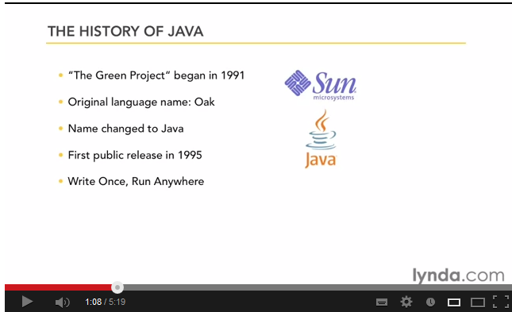
History of Java
Notes:
http://www.youtube.com/watch?v=kfgafdfmwAs

Slide 3

Structure of a Java program
Java code is housed in Classes.
Classes are logically grouped together in Packages.
Classes typically contain variables and methods.
package
class

Slide 4
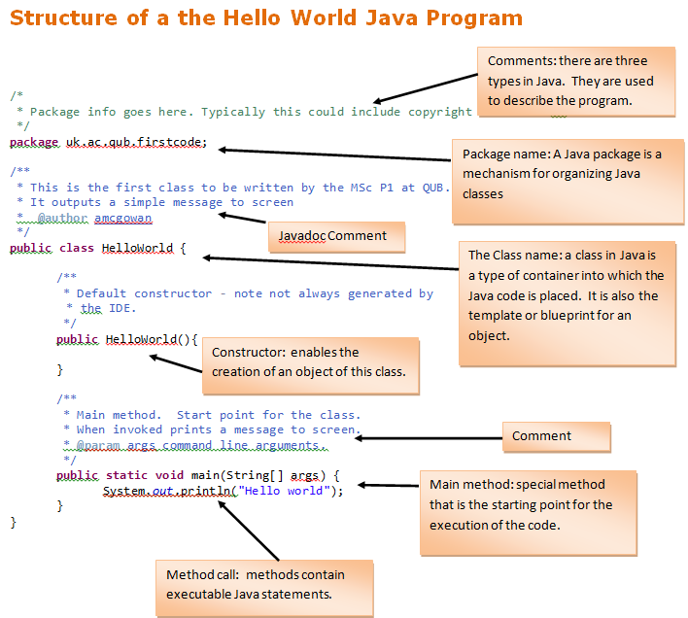
Hello world
A line of Java code finishing with a ; is known as a statement.

Slide 5
Data
All computer programs ‘deal with’ data. They may read data, process data, output data, etc. This may be simple data such as numbers or characters or more complex data such as student records.
This data needs to be stored somewhere ‘within the computer’ so that it can be accessed whenever necessary. To do this programs make use of variables which are simply named locations or blocks within the computer’s memory.
Java distinguishes between two sorts of data
  Values of primitive data types
  Instances of classes (objects)

Slide 6
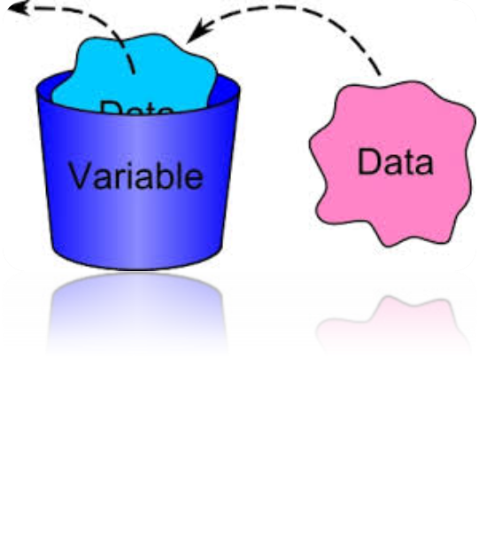
Variables
A variable is a container that holds values that are used in a Java program.
To be able to use a variable it needs to be declared.
Declaring variables is normally the first thing that happens in any program.

Slide 7

Variables
Think of a bucket.
We can fill it to a certain level, we can replace what's inside it, and sometimes we can add or take something away from it.
When we declare a variable to use a data type it's like putting a label on the bucket that says what it can be filled with.
The bucket can then only hold to it’s limit and only can hold what it’s been labelled as.
Notes:
A good analogy for a variable is to think of a bucket. We can fill it to a certain level, we can replace what's inside it, and sometimes we can add or take something away from it. When we declare a variable to use a data type it's like putting a label on the bucket that says what it can be filled with. Let's say the label for the bucket is "Sand". Once the label is attached, we can only ever add or remove sand from the bucket. Anytime we try and put anything else into it, we will get stopped by the bucket police. In Java, you can think of the compiler as the bucket police. It ensures that programmers declare and use variables properly.

Slide 8
Choosing Variable Names
The name given to a variable is known as an identifier.
There are certain rules for identifiers:
No Reserved words.
Cannot start with a digit but digits can be used after the first character (e.g., name1, n2ame are valid).
Start with a letter, an underscore (i.e., "_") or a dollar sign (i.e., "$").
Cannot use other symbols or spaces (e.g., "%","^","&","#").
Should start with lower case names.
Always give your variables meaningful identifiers. If a variable holds the price of a book, then call it something like "bookPrice". If each variable has a name that makes it clear what it's being used for, it will make finding errors in your programs a lot easier.

Slide 9

Camel case
The practice of writing compound words or phrases such that each next word or abbreviation begins with a capital letter. Camel case may start with a capital or, especially in programming languages, or with a lowercase letter.

Slide 10
Primitive data types
Java has 8 primitive data types
Java is a strongly typed programming language. This means that every variable must have a data type associated with it. For example, a variable could be declared to use one of the eight primitive data types: byte, short, int, long, float, double, char or boolean.

Slide 11
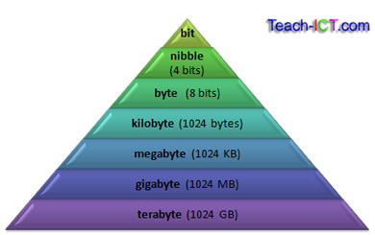
Size up !

Slide 12
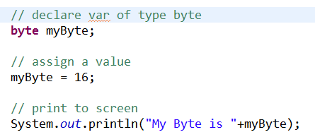
byte
Byte data type is an 8-bit signed two's complement integer.
Minimum value is -128 (-2^7)
Maximum value is 127 (inclusive)(2^7 -1)
Default value is 0
Byte data type is used to save space in large arrays,
mainly in place of integers, since a byte is four times
smaller than an int.

Slide 13
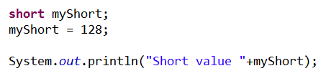
short
Short data type is a 16-bit signed two's complement integer.
Minimum value is -32,768 (-2^15)
Maximum value is 32,767 (inclusive) (2^15 -1)
Short data type can also be used to save memory as byte data type. A short is 2 times smaller than an int
Default value is 0.

Slide 14

int
int data type is a 32-bit signed two's complement integer.
  Minimum value is - 2,147,483,648.(-2^31)
  Maximum value is 2,147,483,647(inclusive).(2^31 -1)
int is generally used as the default data type for integral values unless there is a concern about memory.
The default value is 0.

Slide 15

long
Long data type is a 64-bit signed two's complement integer.
  Minimum value is -9,223,372,036,854,775,808.(-2^63)
  Maximum value is 9,223,372,036,854,775,807 (inclusive). (2^63 -1)
This type is used when a wider range than int is needed.
Default value is 0.

Slide 16

float
Float data type is a single-precision 32-bit IEEE 754 floating point.
Float is mainly used to save memory in large arrays of floating point numbers.
Default value is 0.0f.

Slide 17

double
double data type is a double-precision 64-bit IEEE 754 floating point.
This data type is generally used as the default data type for decimal values, generally the default choice.
Default value is 0.0

Slide 18
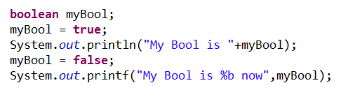
boolean
boolean data type represents one bit of information.
There are only two possible values: true and false.
This data type is used for simple flags that track true/false conditions.
Default value is false.

Slide 19

char
char data type is a single 16-bit Unicode character.
Minimum value is '\u0000' (or 0).
Maximum value is '\uffff' (or 65,535 inclusive).
Char data type is used to store any character.

Slide 20
Reference Data Types
Reference variables are created using defined constructors of the classes. They are used to access objects. These variables are declared to be of a specific type that cannot be changed. For example, Employee, Dog etc.
Class objects, and various type of array variables come under reference data type.
Default value of any reference variable is null.
A reference variable can be used to refer to any object of the declared type or any compatible type.
Example: Animal animal = new Animal("giraffe");

Slide 21
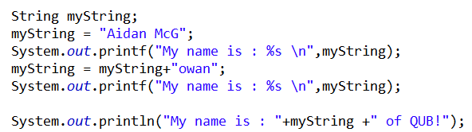
String
Not a Java Primitive type
Concatenation of two strings

Slide 22
Operators
Java’s arithmetic operators
  + additive operator (also used for String concatenation)
  - subtraction operator
  * multiplication operator
  / division operator
  % remainder operator (modulus operator)

Slide 23
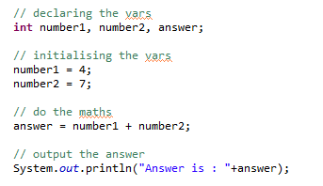
Declaring, initialising and assignment of variables

Slide 24
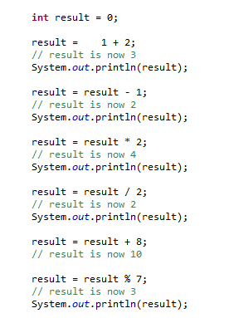
Maths operators in action
The = is known as the assignment operator. It assigns a value to the variable
Everything to the right of the = operator is evaluated before the assignment.
Portions of statements that contain calculations are called expressions.

Slide 25
Decision making – equality and relational operators
A condition is an expression that can be true or false.
Java’s if selection statement allows a program to make a decision based on a condition’s value.
If the condition in the if statement is true the body of the if statement executes otherwise it is ignored.

Slide 26
Decision making – equality and relational operators
Conditions in the if statement are performed by the equality operators and the relational operators
- equality
  == Equal to
  != Not equal to
  - relational
  > Greater than
  >= Greater than or equal to
  < Less than
  <= Less than or equal to

Slide 27
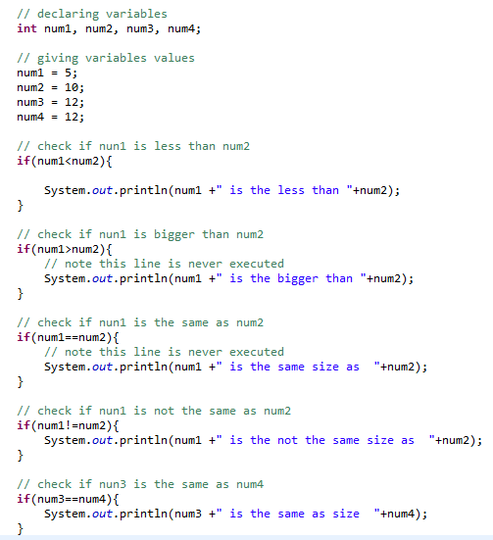

Slide 28
Under the bonnet
The Java Virtual Machine
  Java is platform independent. This means that it will run on just about any operating system. So whether your computer runs Windows, Linux, Mac OS, it’s all the same to Java!
One characteristic of Java is portability, which means that computer programs written in the Java language must run similarly on any supported hardware/operating-system platform.

Slide 29

Portability
Portability is achieved by compiling the Java language code to an intermediate representation called Java bytecode, instead of directly to platform-specific machine code.
Java bytecode instructions are analogous to machine code, but are intended to be interpreted by a Java Virtual Machine (JVM) written specifically for the host hardware.

Slide 30
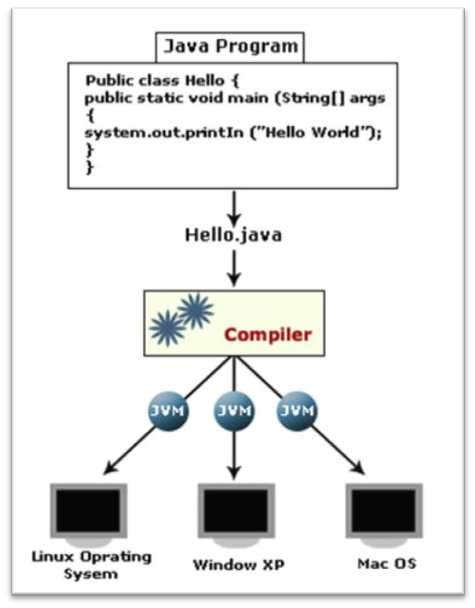
Compiling and running
Developers write the source code which is saved with the file extension .java.
Javac is then used to turn (i.e. compile) this source code into bytecode.
After Javac has finished compiling the bytecode, it creates a new file with the extension .class.
Once the class file has been created, it can be run on the Java Virtual Machine.

